Slide 1
Volunteer Liability
Kelley Reno Culley, MBA, CPCU, CIC

Slide 2
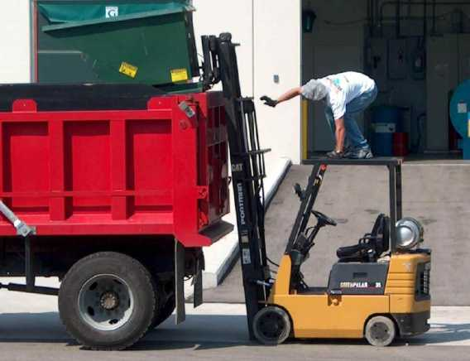
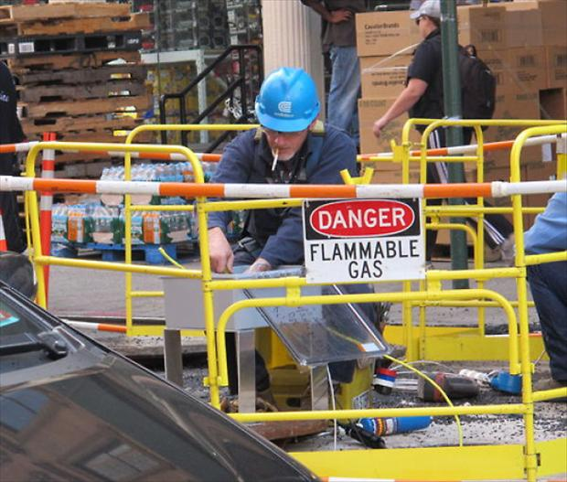
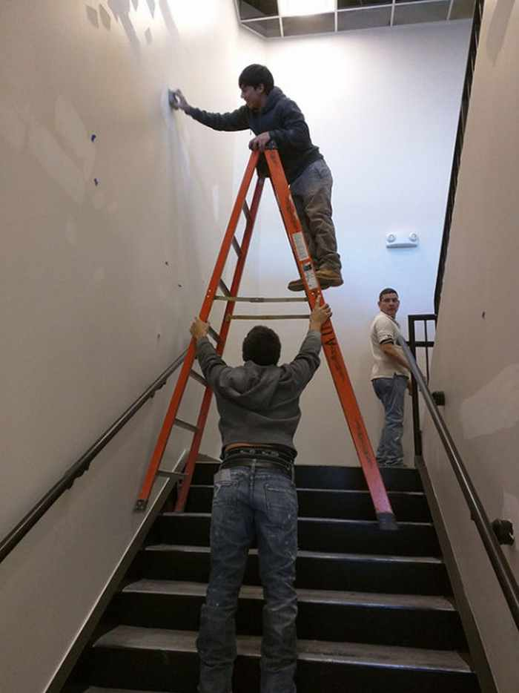
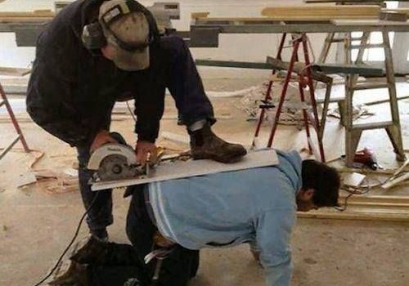
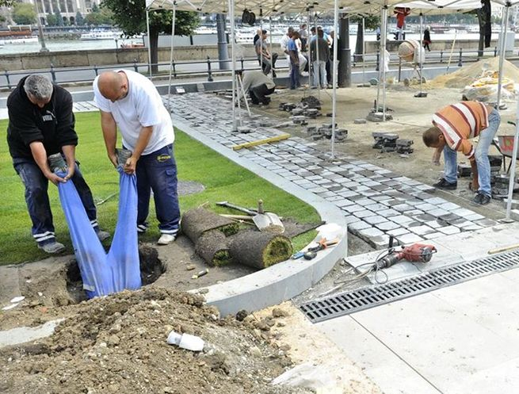
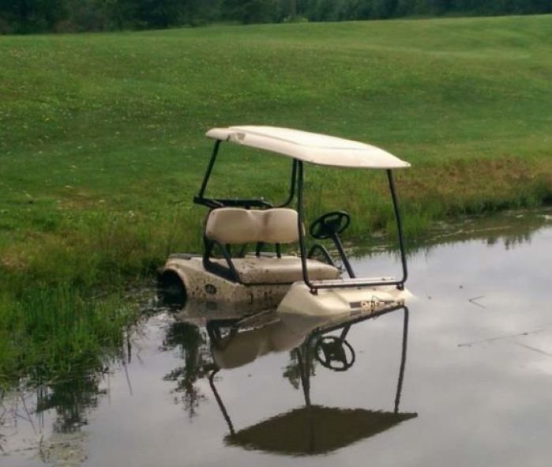
Your Volunteers

Slide 3
Risk Management & insurance
How to Manage Risk?
Accept
Avoid
Reduce
Risk Management Policies
Transfer
Purchase of Insurance

Slide 4
What could go Wrong?
ANYTHING & EVERYTHING!
Risk is present in everything we do!
The reality is that NPs cannot escape risk. It’s part of doing business. What you can do it work to reduce the risk.

Slide 5
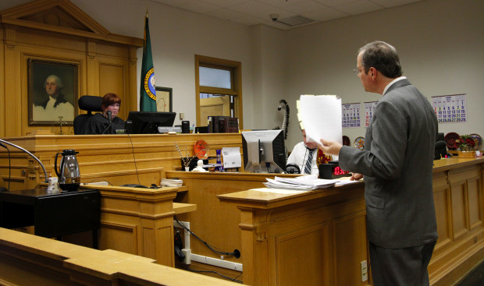
Limited immunity for Volunteers
Federal Level
Volunteers Protection Act 1997
Offers qualified immunity for volunteers for acts of ordinary negligence
State Level
Ohio Revised Code 2305.35
Uncompensated volunteers of non profits charitable organizations have no liability
Meant to encourage people to volunteer by reducing their exposure to personal liability. However, all these laws do is protect the volunteer, not the organization.

Slide 6
Who’s going to sue a Charity?
Charitable Immunity Laws
Fallen out of favor the last 20+ years
False sense of security as an NPO
Injury is grave enough
Children are involved
Outrageous conduct
“Deep Pockets” philosophy
Cost of a suit
Loss or goodwill & reputation makes it harder to raise funds and attract support

Slide 7
Risk Management of Volunteers: Know who’s Volunteering for you
Background Checks
Can save an organization from liability & embarrassment
Allows you to make an informed decision whether the individual is appropriate for your program
Not all willing volunteers should be accepted
Particularly important to check volunteers assisting with organizational finances, handling cash or working with children, seniors or developmentally disabled individuals
Check with your insurance carrier/agent or association for access to discounted background checks
Motor Vehicle Reports
Especially if they are driving for you or on your behalf
Verify their license is valid & review violations
Keep a copy for your records
Your insurance carrier/agent should be able to help with running these reports

Slide 8
Risk Management of Volunteers: Training
Volunteers need to understand what the NPO expects in regard to their conduct within the workplace
Provide supervision, direction, and training consistent with the volunteer’s activities and the NPOs policies and practices
NPOs should clearly determine the manner, the means and the schedule for completing volunteer activities
Volunteers should understand clearly their job duties and what they are allowed to have control over
Mentoring of new volunteers with experienced volunteers to provide on-the-job guidance
Documentation & Oversight

Slide 9
Risk Management of Volunteers: Policies
Onboarding process for every new volunteer, similar to employee onboarding
Factor volunteers into harassment and discrimination policies
Cyber security procedures
Passwords, two step verification
Safety Procedures
Procedure for reporting concerns
Notifying staff about or cleaning up potential hazards
First Aid & CPR Training
Reporting of harassment
Substance abuse policies

Slide 10
Risk Management of Volunteers: Injury to the Volunteer
Workers Compensation
Ohio is a Monopolistic State
No compensation, no access to workers comp benefits
By default, volunteer injuries should be covered under the Commercial General Liability policy
If the NP is deemed to be legally liable
This is not a catch all, action must not be excluded
Volunteer Waivers

Slide 11
Risk Management of Volunteers: Transfer the risk
Insurance is only part of risk management, insurance is not designed to prevent loss it’s designed to transfer the cost of the loss
Have a knowledgeable insurance agent put together a plan for your organization
Update your agent as your organization grows and makes decisions
Ask questions and ask for explanations
Three important lines of insurance coverage for NPs regarding volunteers:
Directors & Officers Coverage
Employment Practices
Commercial General Liability

Slide 12
Directors & Officers Coverage
“Management errors & omissions liability insurance”
Non Profit Directors and Officer boards can be sued by donors, employees (prospective, current or former), the general public, volunteers, third parties, clients and or government agencies.
Personal assets of board members are at stake, By-laws of the NP may indemnify the board, but does not guarantee the NP has the resources to fund the cost of a claim.
Directors of NP boards have the same fiduciary duty as corporate board members. NP D&O lawsuits may involve a variety of issues related to the daily operation of a board including:
Duty of Care – requires D&O to act prudently and reasonably in regard to the management of the organization's affairs.
Duty of Loyalty – prohibits D&O from using their position in the organization to further their own personal interest.
Duty of Obedience – requires D&O to endure the organization is run in accordance with it’s charter and bylaws, and that the organization complies with applicable laws.

Slide 13
Employment Practices
Covers not only actual, but also alleged acts of discrimination, harassment, retaliation, wrongful termination and other similar acts
Financial ramification of an EP suit could cripple the operating budget of small NPOs who are not able to handle the defense costs, let along settlement or judgements
Make sure your EPLI coverage includes not only employees, but also volunteers

Slide 14
Commercial General Liability Coverage A – Bodily Injury / Property Damage - What does it do (cover)?
Pays for sums the insured becomes legally obligated to pay as damages because of “bodily injury” or “property damage”
Pays only if caused by an occurrence, occurs during the policy period and in the coverage territory
Right and duty to defend the insured against any “suit” seeking those damages
Investigate and settle at their discretion

Slide 15
Coverage A – Bodily Injury / Property Damage
What does it not do (cover)? | And why?
Expected or intended injury | Uninsurable
Contractual Liability | Some can be covered – such as the lease of a premise
Liquor Liability | Except if you are not in the business of manufacturing, distributing, selling or serving; Host liquor is available
Worker’s Compensation | Buy a Worker’s Comp policy
Employer’s Liability | Buy Employer’s Liability Coverage
Pollution | Some coverage, but this exposure is better served through a Pollution Liability Policy
Aircraft, Auto or Watercraft | Buy an auto, aircraft or watercraft policy
Mobile Equipment | Buy an auto policy
War | Uninsurable
Damage to Property | Buy a property policy
Damage to Your Product | Uninsurable
Damage to Your Work | Uninsurable
Damage to Impaired Property | Uninsurable
Recall of Products, Work , or Impaired Property | Buy Products recall coverage
Electronic Data | Can be bought back by endorsement
Employment Related Practices | Buy Employment practices coverage
Personal & Advertising Injury | Covered under coverage B

Slide 16
Coverage B - Personal & Advertising Injury
What does it cover? False arrest, detention Malicious prosecution Slander or liable Violations of another’s right or privacy Use of another’s idea in advertisements Copyright infringement | What does it not cover? Insured in Media and internet type businesses - advertising, broadcasting, publishing, or designing website. (buy a professional liability policy) Knowingly violating the rights of others Publishing material with knowledge of falsity Criminal acts Unauthorized use of another’s name or product Electronic chatrooms or bulletin boards (Facebook)

Slide 17
Odds & Ends Insurance advice for your organization
Commercial Auto
Hired & Non Owned Auto
Crime
Cyber Liability

Slide 18
Pay attention to Named Insured & Additional Insureds
Named insureds own the policy
Don’t let anyone else own your insurance
Additional Insureds are contractual
Question who wants to be an AI and why?

Slide 19
What if I hire someone to do work for me?
Current Date
Company or Person you are hiring
Effective Date & Limits
Your name
goes here

Slide 20
Questions?
Kelley Reno Culley
Kelley@RenoInsuranceAgency.com
(937) 223-5235
Reno Insurance Agency
228 Byers Rd. Ste 103
Miamisburg, OH 45342

